Slide 1
A multi-reader multi-case randomized controlled clinical trial to evaluate the performance of AI-assisted diagnosis of pneumothorax (PTX 气胸）
Oct 28, 2020

Slide 2
Agenda
Introduction
Trial design
Statistical considerations
Summary

Slide 3
Introduction

Slide 4
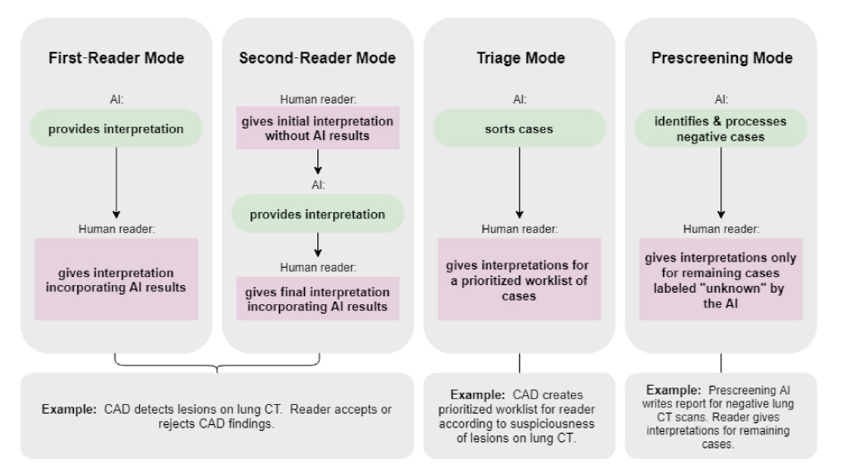
Four use cases for AI
N.A. Obuchowski, J.A. Bullen. Statistical considerations for testing an AI algorithm used for prescreening lung CT images. Contemporary Clinical Trials Communications. 2019 (16).
Notes:
CAD – computer assisted detection with AI algorithm

Slide 5
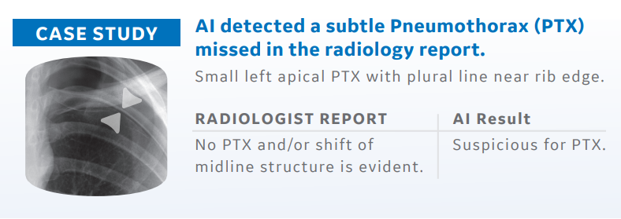
Background
Pneumothorax (PTX) is a critical condition that needs urgent diagnosis and potentially a life saving intervention – unfortunately a diagnosis is sometimes delayed or even missed, resulting in 500 million per year in USA medical error cost. GE Healthcare is developing AI solutions to detect and help prioritize critical cases to radiologist.

Slide 6
AI solution for PTX
Xxx is developing an artificial intelligence (AI) based solution to help healthcare providers optimize their workflow by providing notifications when an image shows critical finding or suspicious finding. CCS is a computer-aided triage, notification, and diagnostic device that analyzes frontal chest X-ray images for the presence of PTX and flags these images to enable case prioritization / triage and assist in their detection and diagnosis in the workstation.
XXX’s AI based solution employs a collection of AI algorithms designed to identify and flag images to radiologists for suspicious critical findings. The system immediately brings AI findings in the form of a notification to radiologist to enable case prioritization or triage, without disrupting their workflow.

Slide 7
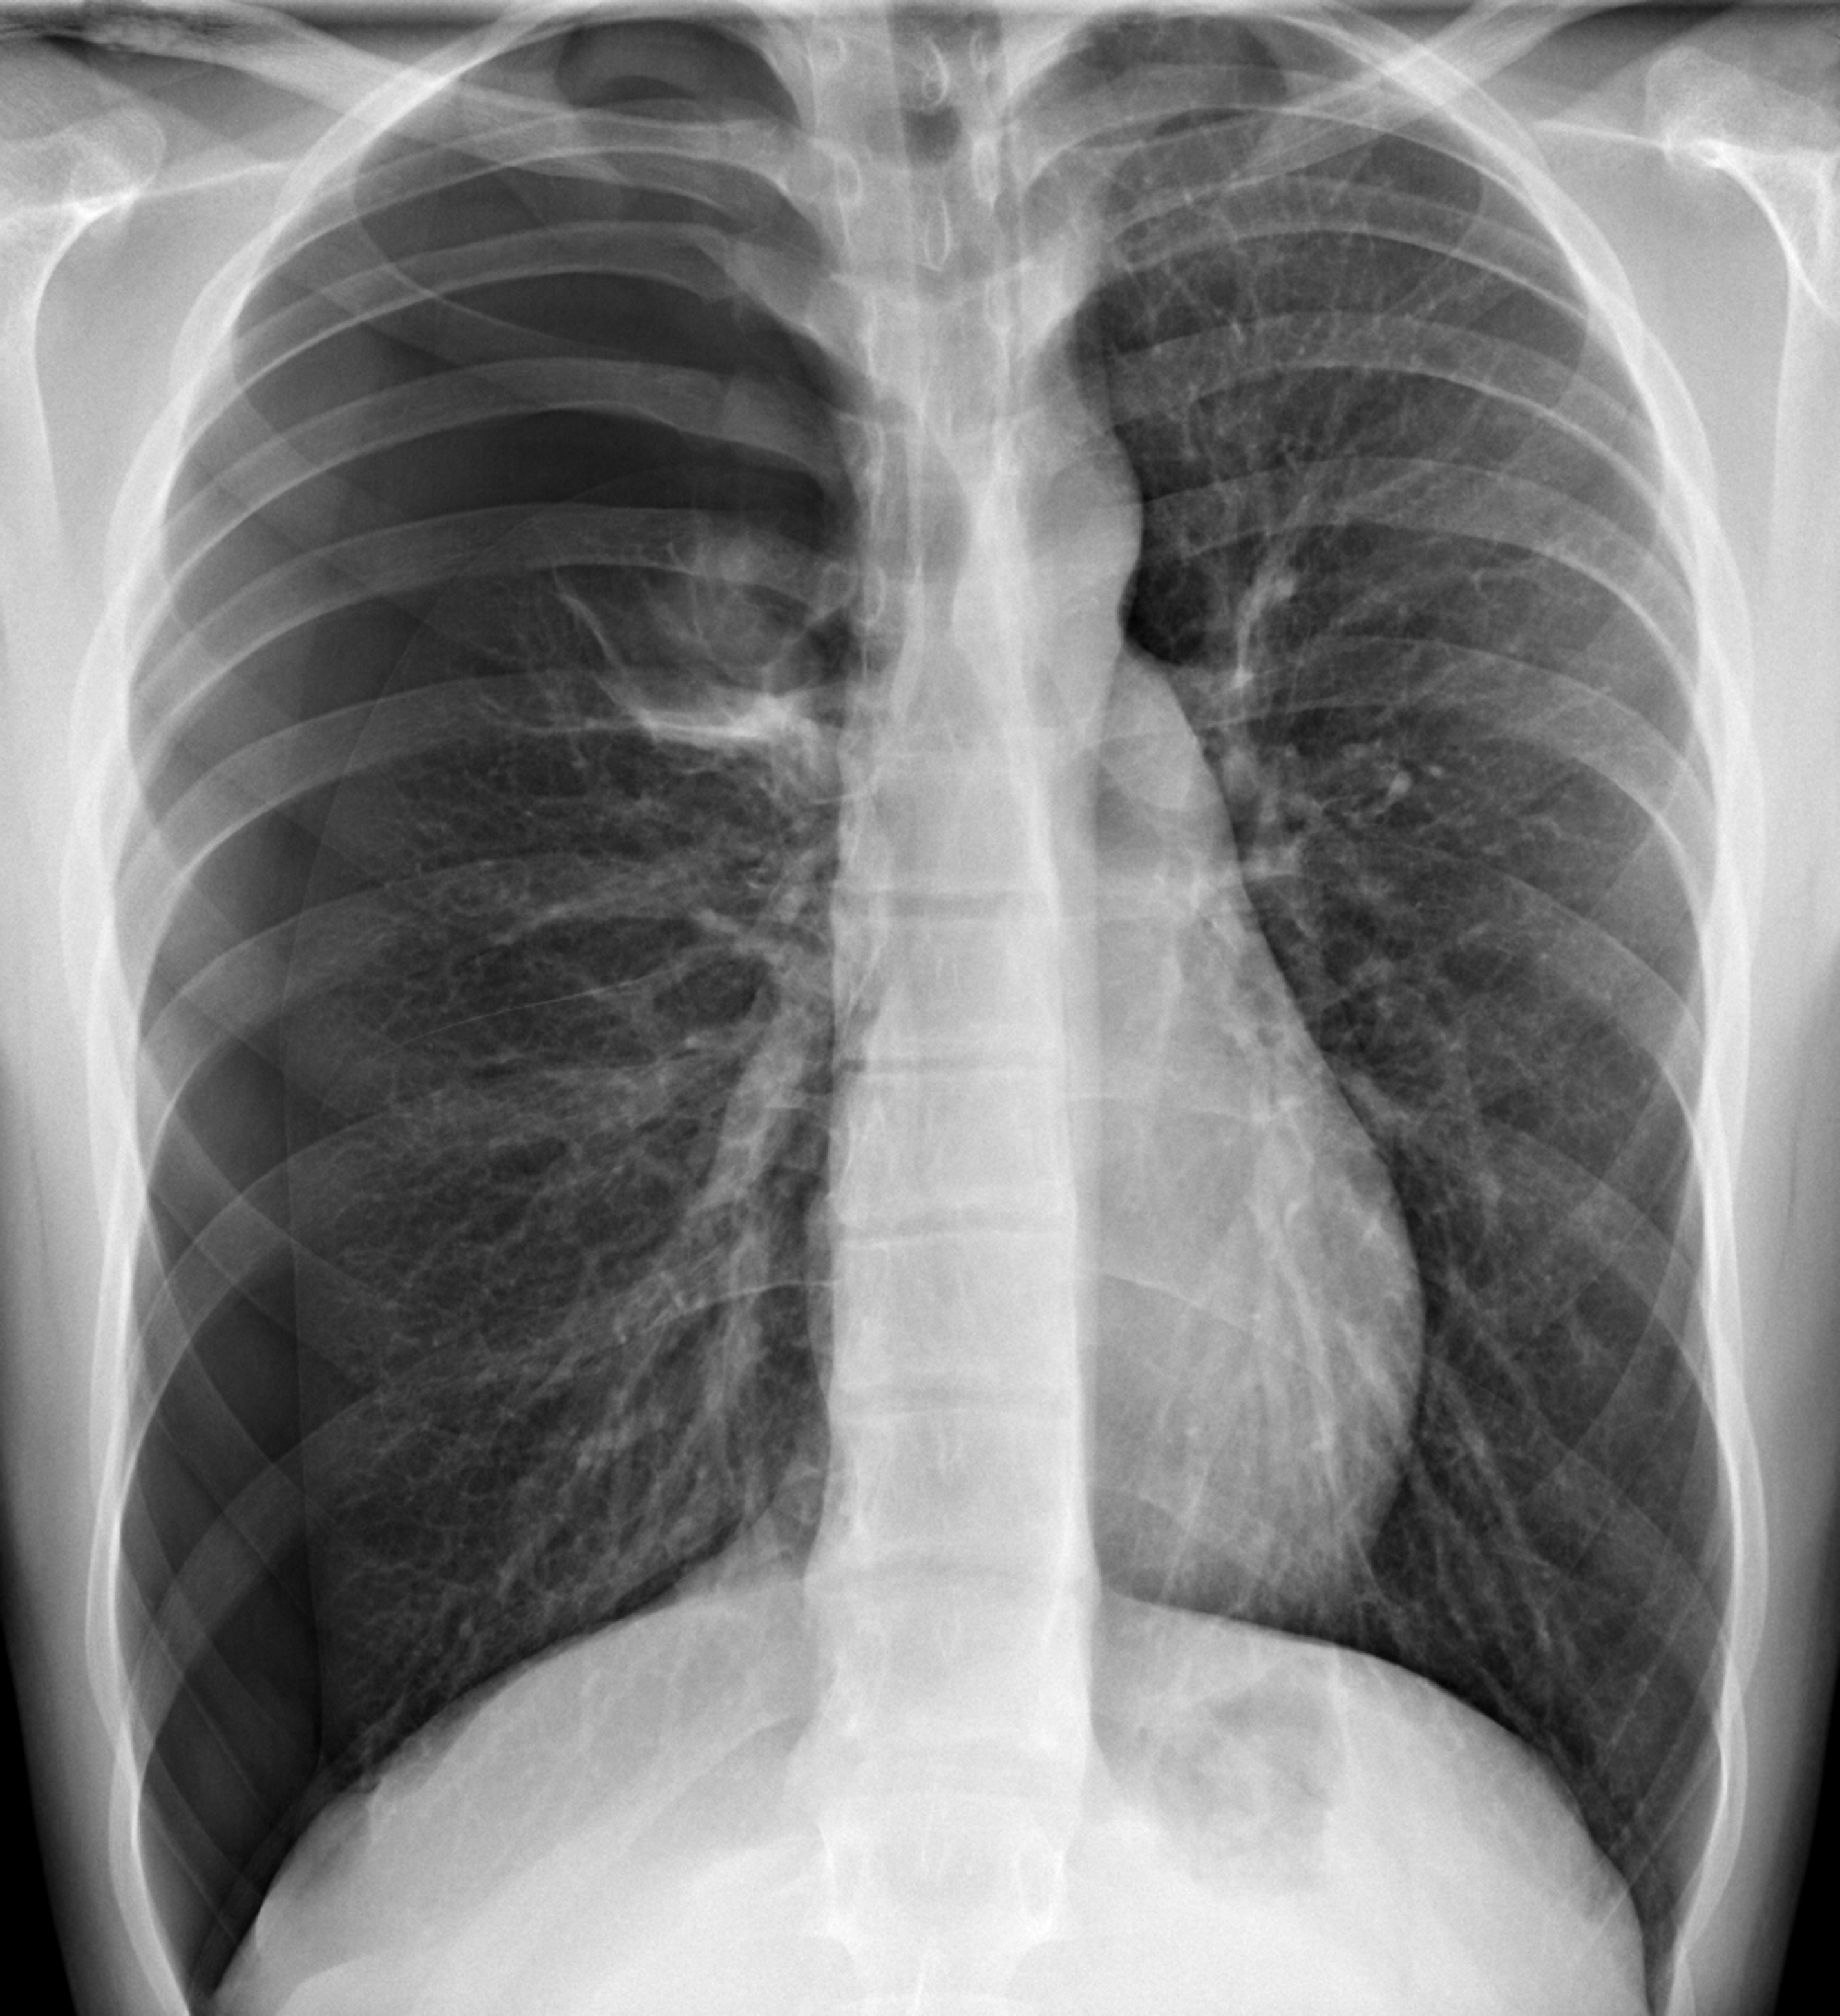
How to evaluate the AI PTX solutions
Radiologist diagnosis with AI assist
AI diagnosis
VS
VS
Radiologist diagnosis
Radiologist diagnosis

Slide 8
Trial Design

Slide 9
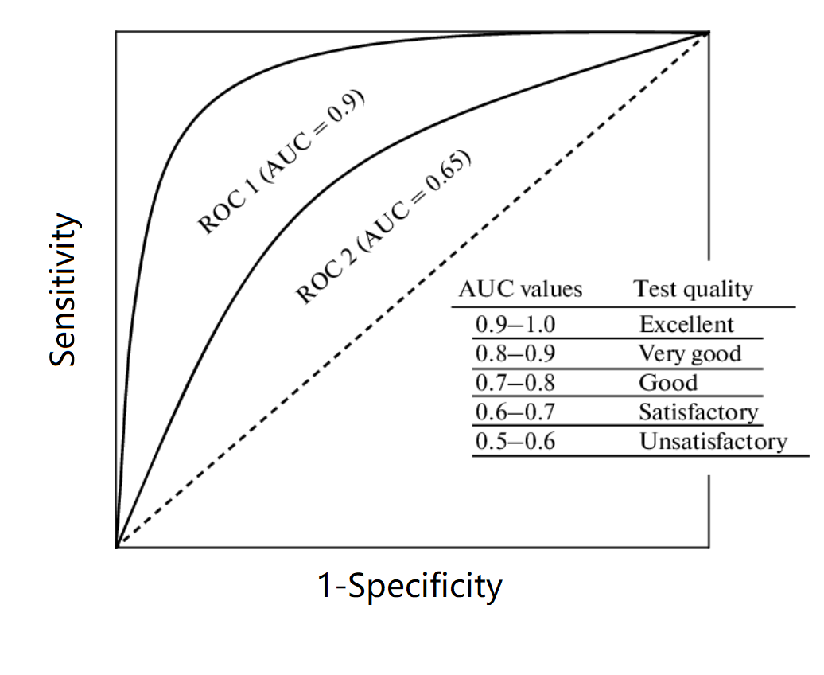
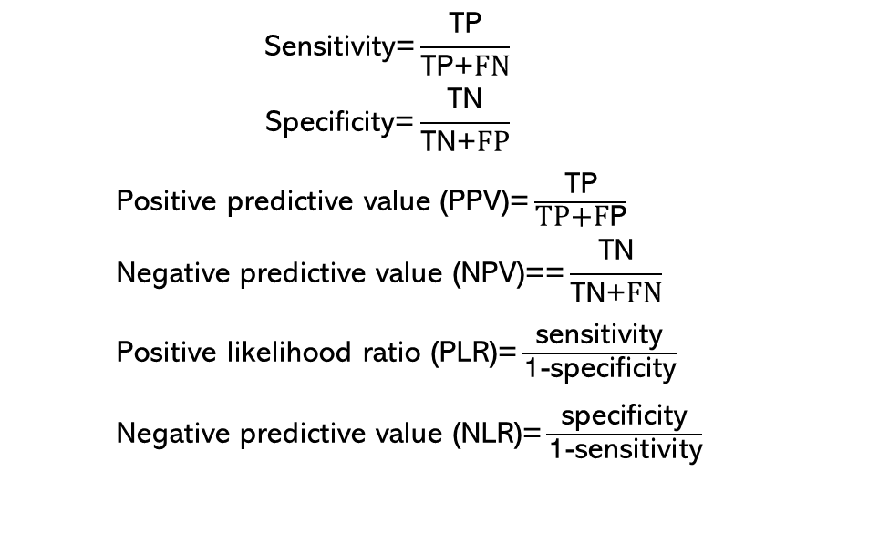
Measures of diagnostic accuracy
 |  | Gold standard
 |  | Disease | Non-Disease
Test output | Positive( Presence) | True positive (TP) | False Positive (FP)
 | Negative (Absence) | False Negative (FN) | True Negative (TN)
$$\text{Sensitivity}\text{=}\frac{\text{TP}}{\text{TP}\text{+}FN}$$
$$\text{Specificity}\text{=}\frac{\text{TN}}{\text{TN}\text{+}FP}$$
Positive predictive value ($\text{PPV}\text{)}\text{=}\frac{\text{TP}}{\text{TP}\text{+}\text{F}\text{P}}$
$$\text{Negative} \text{predictive} \text{value}\text{ (}\text{N}\text{PV}\text{)==}\frac{\text{TN}}{\text{TN}\text{+}FN}$$
Positive likelihood ratio ($\text{PLR}\text{)=}\frac{\text{sensitivity}}{\text{1−}\text{specificity}}$
Negative predictive value ($\text{NLR}\text{)=}\frac{\text{specificity}}{\text{1−}\text{sensitivity}}$

Slide 10
Objective
To show the use of the AI algorithm will improve the reader’s (Board-certified Radiologist, Radiology Resident, Non-Radiologist Physician and Physician assistant) performance in the diagnosis of the PTX

Slide 11
Primary endpoint
Readers will independently score each case by answering a 7 point scale questionnaire. The readers will answer a questionnaire indicating their level of confidence in detecting PTX
Superiority of radiologist performance with AI over radiologist performance
without AI using ROC AUC
H₀: (AUC_{AI} – AUC_{noAI}) = 0
versus
H₁: (AUC_{AI} - AUC_{noAI}) ≠ 0.
  1- Pneumothorax is definitely not present
  2- Pneumothorax is almost certainly not present
  3- Pneumothorax is probably not present
  4- Pneumothorax is possibly present
  5- Pneumothorax is probably present
  6- Pneumothorax is almost certainly present
  7- Pneumothorax is definitely present

Slide 12
Secondary endpoints
Non-inferiority on Sensitivity
Non-inferiority on Specificity
Superiority on Sensitivity
Superiority on Specificity
The fixed-sequence method will be used to test primary and secondary hypotheses in a predefined order, at the same significance level alpha (α = 0.05).

Slide 13
Exploratory Objectives
Positive and negative likelihood ratios ( PLR and NLR) analysis
Size of PTX findings – small / large
Reader subgroup analysis
Individual reader analysis

Slide 14
MRMC design
Multiple readers will be involved to account for the variability in the training level and experience of the readers, and the result can be generalized to the population of readers.
The clinical performance assessment of AI aided devices is typically performed by utilizing a multiple reader multiple case (MRMC) study design, where a set of clinical readers evaluate image data under multiple reading conditions or modalities (e.g., readers unaided versus readers aided by AI). The MRMC design can be “fully-crossed” whereby all readers independently read all of the cases. This design offers the greatest statistical power for a given number of cases.

Slide 15
Statistical Considerations

Slide 16
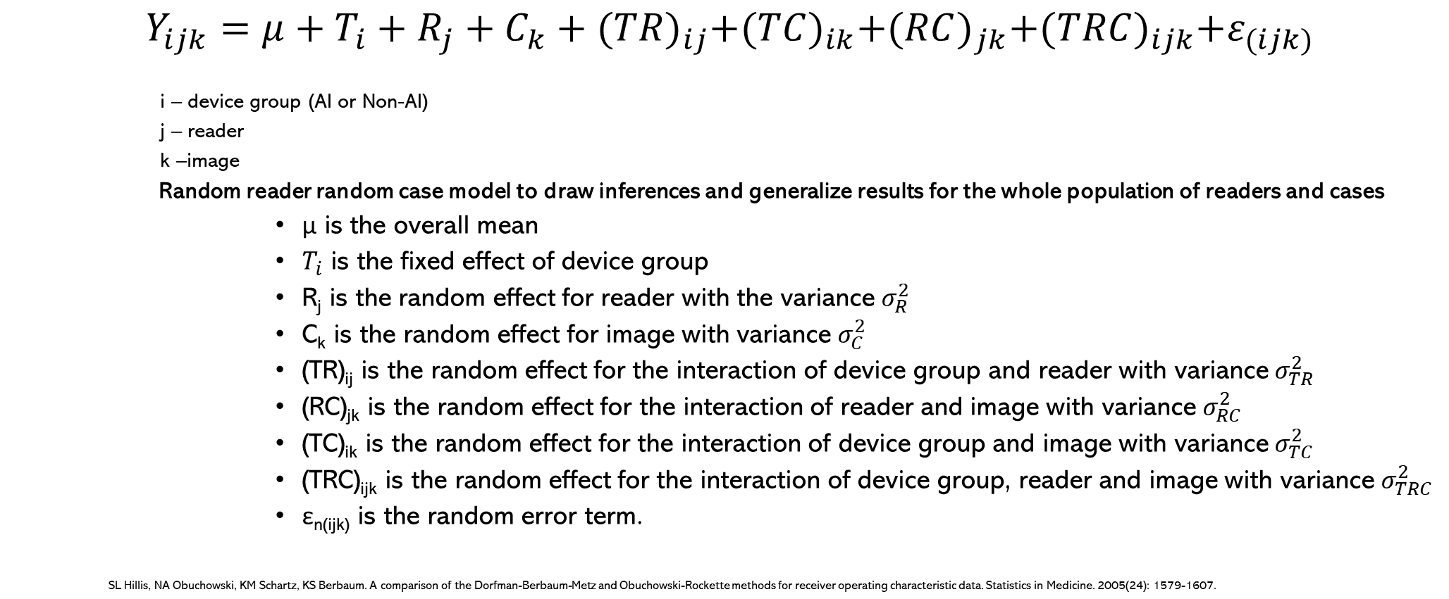
Statistical model
$Y_{ijk}=μ+T_{i}+R_{j}+C_{k}+{(TR)}_{ij}+{(TC)}_{ik}+{(RC)}_{jk}+{(TRC)}_{ijk}+ε_{(ijk)}$
    i – device group (AI or Non-AI)
    j – reader
    k –image
    Random reader random case model to draw inferences and generalize results for the whole population of readers and cases
          μ is the overall mean
          $T_{i}$ is the fixed effect of device group
          R_{j} is the random effect for reader with the variance $σ_{R}^{2}$
          C_{k} is the random effect for image with variance $σ_{C}^{2}$
          (TR)_{ij} is the random effect for the interaction of device group and reader with variance $σ_{TR}^{2}$
          (RC)_{jk} is the random effect for the interaction of reader and image with variance $σ_{RC}^{2}$
          (TC)_{ik} is the random effect for the interaction of device group and image with variance $σ_{TC}^{2}$
          (TRC)_{ijk} is the random effect for the interaction of device group, reader and image with variance $σ_{TRC}^{2}$
          ε_{n(ijk)} is the random error term.
SL Hillis, NA Obuchowski, KM Schartz, KS Berbaum. A comparison of the Dorfman-Berbaum-Metz and Obuchowski-Rockette methods for receiver operating characteristic data. Statistics in Medicine. 2005(24): 1579-1607.

Slide 17
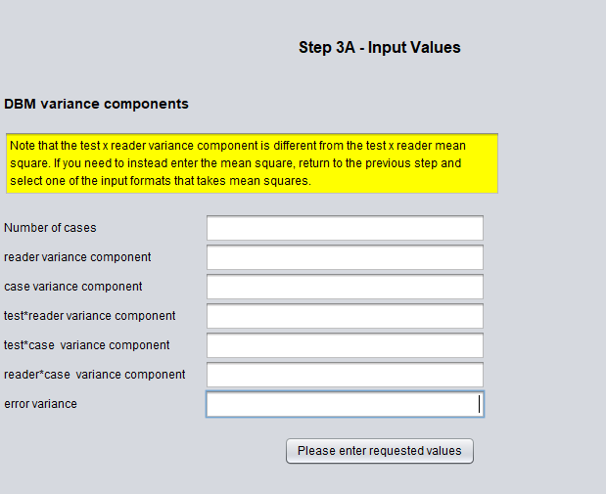
Sample size determination
Parameters estimated from pilot data
  Type I error
  Power
  Variance components
  Effect size
  Reader number
Using parameters to estimate the sample size
Estimate the reader number firstly
Estimate the image / case number secondly

Slide 18
Random stratified sampling
Retrospective trial design
A total of xxx images which randomly selected from images passed the quality checking will be included in this study. This will be a stratified random sampling by using SAS procedure PROC SURVEYSELECT, accounting PTX ground truth and size as stratum.

Slide 19
Randomization (I)
Cross-over design
Reading group | Reader (randomization) | Period 1 (randomization) | Wash-out period | Period 2 (randomization)
1 (AI first, non-AI second) | Randomize ½ readers into group 1 | Read all images with AI | 4 weeks | Read all images without AI
2 (non-AI first, AI second) | Randomize ½ readers into group 2 | Read all images without AI | 4 weeks | Read all images with AI

Slide 20
Randomization (II)
Multiple randomization procedures will be performed to randomize readers, images, and application of AI.
Reading group | Reader | Period 1 (Reading all images with random order) | Wash-out period | Period 2 (Reading all images with random order)
1 (AI first, non-AI second) | Reader 1 | A B C D | 4 weeks | B A C D
 | Reader 3 | A C D B |  | C D A B
 | Reader 4 | C A D B |  | D A C B
2 (non-AI first, AI second) | Reader 2 | A C B D | 4 weeks | A B C D
 | Reader 5 | A D B C |  | A D C B
 | Reader 6 | D A B C |  | D A C B

Slide 21
Randomization (III)
Reader | Sequence | Group | Order 1 | Order 2 | Order 3 | Order 4 | Order 5 | Order 6 | Order 7 | Order 8 | Order 9 | Order 10
1 | First period | Without AI | Image 5 | Image 6 | Image 9 | Image 1 | Image 2 | Image 3 | Image 4 | Image 7 | Image 8 | Image 10
1 | Second period | With AI | Image 5 | Image 4 | Image 7 | Image 9 | Image 3 | Image 1 | Image 8 | Image 2 | Image 6 | Image 10
2 | First period | With AI | Image 8 | Image 10 | Image 1 | Image 4 | Image 6 | Image 7 | Image 3 | Image 5 | Image 2 | Image 9
2 | Second period | Without AI | Image 2 | Image 5 | Image 8 | Image 1 | Image 10 | Image 4 | Image 3 | Image 6 | Image 7 | Image 9
3 | First period | Without AI | Image 10 | Image 4 | Image 7 | Image 5 | Image 1 | Image 2 | Image 8 | Image 6 | Image 9 | Image 3
3 | Second period | With AI | Image 4 | Image 1 | Image 6 | Image 10 | Image 8 | Image 9 | Image 7 | Image 5 | Image 2 | Image 3
4 | First period | With AI | Image 4 | Image 5 | Image 2 | Image 6 | Image 7 | Image 9 | Image 10 | Image 1 | Image 3 | Image 8
4 | Second period | Without AI | Image 6 | Image 2 | Image 3 | Image 4 | Image 9 | Image 5 | Image 10 | Image 7 | Image 8 | Image 1

Slide 22
Blinding
Readers will be masked to the reference standard and image acquisition interpretations for each case. Readers will not have access to prior mammograms or other clinical information. All readers will perform their interpretations independently.
Readers will not be masked to the AI or Non-AI reading.

Slide 23
Analysis sets
The full analysis set (FAS) will consist of all cases included in the reader study, having a definitive standard of truth assessment.
The per protocol set (PPS) will consist of all cases included in the reader study, without any critical protocol deviations, and having a definitive standard of truth assessment.
If FAS and PPS are same, i.e., there is no critical protocol deviations, the statistical analysis is carried out only for FAS.

Slide 24
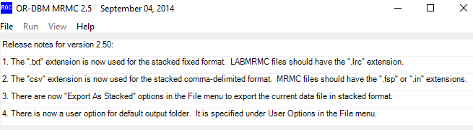
Statistical data analysis
We will obtain the average AUC within each modality and its standard error, and the mean difference in AUC for AI versus Non-AI and its standard error. Two-sided 95% CIs for AUC of AI, non-AI and AUC difference will be provided with the p value.
Reader performance analysis (AUC) will be performed using the software package OR-DBM MRMC 2.4, written by Kevin M.Schartz, Stephen L. Hillis, Lorenzo L. Pesce, and Kevin S. Berbaum, and freely available at http://perception.radiology.uiowa.edu.
Other analysis will be performed using SAS 9.4.

Slide 25
Summary
Design has been ready
Due to covid-19, study has not been started.
Data analysis will be on next year

Slide 26
Thanks!
Any questions?

